Slide 1


081100M01002H 图像处理与分析 第七讲: 图像变换 (V); 图像的统计描述 图像的奇异值分解 图像的统计描述；随机变量和随机场
Lecture 7 October 24, 2019

Slide 2
关于编程作业的评述
注意在互相帮助完成作业时避免出现涉及抄袭的情况
关于作业评分的说明
关于公布作业范本的说明
关于图像正交变换参考阅读材料的说明
Notes:
As you will see again and again in the class, to understand bioimage informatics depends critically on understanding the biological background of bioimage informatics. This is because bioimage informatics is created to answer biological questions rather than for technological curiosity. If we do not understand the biological questions, we will not be able to understand bioimage informatics. So for this reason we need to build some background knowledge about biology, and specifically for this lecture about cell biology.
For the most part of this course, our discussion on biology will be on a level that will be quite comfortable for you.
After that I will give you some historical perspectives and talk about where does it come from. Then I will discuss the learning objectives that we plan to achieve in this class. And finally I will go through the course syllabus together with you and discuss some details.

Slide 3
关于第二次编程作业的反馈 (I)
代码问题
问题一
卷积核的大小，长宽不一定一样，但应为奇数。
卷积操作中卷积核需旋转180度。
问题二
m过小警告不应随意给出，而是2 * round_up(3 * sig) + 1。

Slide 4
关于第二次编程作业的反馈 (II)
问题三
和自带滤波函数对比时应确认对比函数的padding类型。
matlab代码中：
% replicate
imgaussfilt(gray_img,sig,'FilterSize',gau_ker_size,'padding','replicate');
% zero
imgaussfilt(gray_img,sig,'FilterSize',gau_ker_size,'padding',0);
python opencv库中：
GaussianBlur函数默认padding方式为：BORDER_REFLECT_101
其他包括：
Enum cv::BorderTypes {
cv::BORDER_CONSTANT = 0,
cv::BORDER_REPLICATE = 1,
cv::BORDER_REFLECT = 2,
cv::BORDER_WRAP = 3,
cv::BORDER_REFLECT_101 = 4,
cv::BORDER_TRANSPARENT = 5,
cv::BORDER_REFLECT101 = BORDER_REFLECT_101,
cv::BORDER_DEFAULT = BORDER_REFLECT_101,
cv::BORDER_ISOLATED = 16
}
2. zero和replicated两种padding方式比较最好从数值结果（做差值）和观察两个角度分析。

Slide 5
关于第二次编程作业的反馈 (III)
二 报告问题
结果展示问题：
请将图片结果粘贴在报告中，而不仅仅是保存在文件夹中。
图片结果较多，请注意有逻辑地排放，不要一页放一幅图，一次性放20几页的情况，影响结果展示。
图片结果需进行图例说明，以便理解。
图片结果应粘贴原图，无需截图无关的部分（比如桌面）。

Slide 6
内容提要
图像的奇异值分解与逼近
图像的统计描述的基本概念
概率论基础 (复习)
随机变量和随机过程 (复习)
随机场的基本概念
图像的空间域模型
Notes:
As you will see again and again in the class, to understand bioimage informatics depends critically on understanding the biological background of bioimage informatics. This is because bioimage informatics is created to answer biological questions rather than for technological curiosity. If we do not understand the biological questions, we will not be able to understand bioimage informatics. So for this reason we need to build some background knowledge about biology, and specifically for this lecture about cell biology.
For the most part of this course, our discussion on biology will be on a level that will be quite comfortable for you.
After that I will give you some historical perspectives and talk about where does it come from. Then I will discuss the learning objectives that we plan to achieve in this class. And finally I will go through the course syllabus together with you and discuss some details.

Slide 7
图像的奇异值分解与逼近
图像的统计描述的基本概念
概率论基础 (复习)
随机变量和随机过程 (复习)
随机场的基本概念
图像的空间域模型
Notes:
As you will see again and again in the class, to understand bioimage informatics depends critically on understanding the biological background of bioimage informatics. This is because bioimage informatics is created to answer biological questions rather than for technological curiosity. If we do not understand the biological questions, we will not be able to understand bioimage informatics. So for this reason we need to build some background knowledge about biology, and specifically for this lecture about cell biology.
For the most part of this course, our discussion on biology will be on a level that will be quite comfortable for you.
After that I will give you some historical perspectives and talk about where does it come from. Then I will discuss the learning objectives that we plan to achieve in this class. And finally I will go through the course syllabus together with you and discuss some details.

Slide 8
奇异值分解 (I)
https://www.youtube.com/watch?v=Nx0lRBaXoz4
Lecture on SVD by Prof. Gilbert Strang
http://open.163.com/special/opencourse/daishu.html

Slide 9
奇异值分解 (II)

Slide 10
奇异值分解 (III)

Slide 11
图像的SVD逼近 (I)
矩阵A表示为秩为1的矩阵的加权和

Slide 12
矩阵的各种范数

Slide 13
矩阵的各种范数计算示例

Slide 14
图像的奇异值分解的应用 (I)

Slide 15
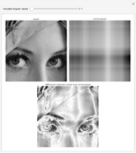
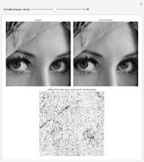
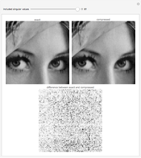
图像的奇异值分解的应用 (II): 图像压缩和去噪声
https://demonstrations.wolfram.com/ImageCompressionViaTheSingularValueDecomposition/
http://timbaumann.info/svd-image-compression-demo/

Slide 16
图像的奇异值分解与逼近
图像的统计描述的基本概念
概率论基础 (复习)
随机变量和随机过程 (复习)
随机场的基本概念
图像的空间域模型
Notes:
As you will see again and again in the class, to understand bioimage informatics depends critically on understanding the biological background of bioimage informatics. This is because bioimage informatics is created to answer biological questions rather than for technological curiosity. If we do not understand the biological questions, we will not be able to understand bioimage informatics. So for this reason we need to build some background knowledge about biology, and specifically for this lecture about cell biology.
For the most part of this course, our discussion on biology will be on a level that will be quite comfortable for you.
After that I will give you some historical perspectives and talk about where does it come from. Then I will discuss the learning objectives that we plan to achieve in this class. And finally I will go through the course syllabus together with you and discuss some details.

Slide 17
为什么需要对于图像进行统计描述？(I)
示例1：每个像素的灰度信号受到噪声的影响是一个随机变量。
示例2：两个或者多个像素的灰度直接的关系可以用多维随机向量的分布描述。

Slide 18
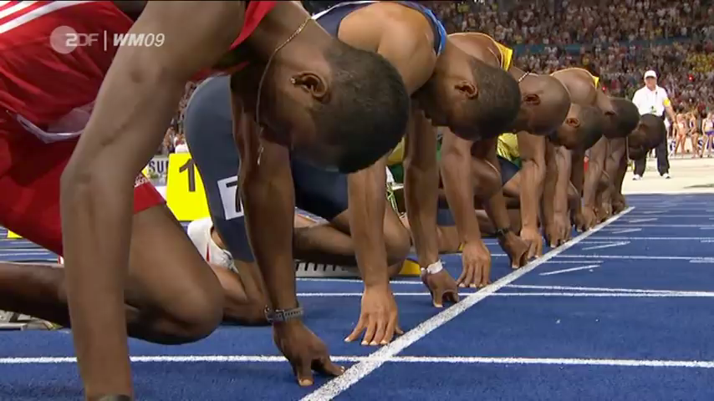
为什么需要对于图像进行统计描述？(II)
示例3：动态图像中单个像素的灰度信号是一个时域随机过程。
示例4：不同位置的像素灰度可以看成是一个一维空间域随机过程或者二维空间域随机场。

Slide 19
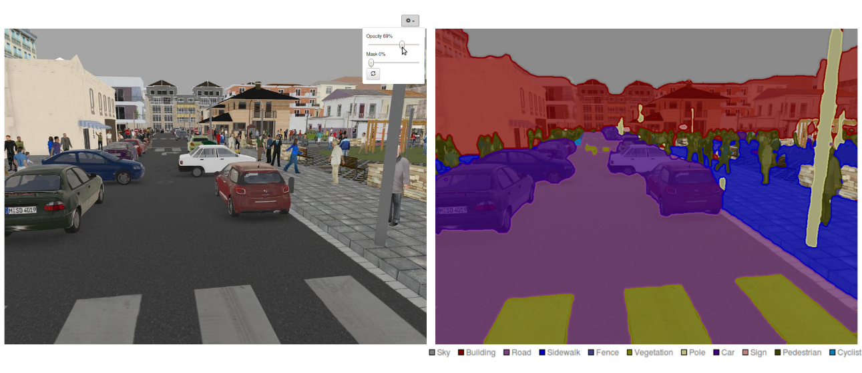
为什么需要对于图像进行统计描述？(III)
示例5：物体的分类与识别
示例6：物体的分割

Slide 20
图像的统计描述是图像处理与计算机视觉的核心概念与方法。
对于图像进行统计描述不仅非常自然而且使得我们可以采用概率与统计方法对于图像进行处理和理解。

Slide 21
图像的奇异值分解与逼近
图像的统计描述的基本概念
概率论基础 (复习)
随机变量和随机过程 (复习)
随机场的基本概念
图像的空间域模型
Notes:
As you will see again and again in the class, to understand bioimage informatics depends critically on understanding the biological background of bioimage informatics. This is because bioimage informatics is created to answer biological questions rather than for technological curiosity. If we do not understand the biological questions, we will not be able to understand bioimage informatics. So for this reason we need to build some background knowledge about biology, and specifically for this lecture about cell biology.
For the most part of this course, our discussion on biology will be on a level that will be quite comfortable for you.
After that I will give you some historical perspectives and talk about where does it come from. Then I will discuss the learning objectives that we plan to achieve in this class. And finally I will go through the course syllabus together with you and discuss some details.

Slide 22
概率论复习

Slide 23
图像的奇异值分解与逼近
图像的统计描述的基本概念
概率论基础 (复习)
随机变量和随机过程 (复习)
随机场的基本概念
图像的空间域模型
Notes:
As you will see again and again in the class, to understand bioimage informatics depends critically on understanding the biological background of bioimage informatics. This is because bioimage informatics is created to answer biological questions rather than for technological curiosity. If we do not understand the biological questions, we will not be able to understand bioimage informatics. So for this reason we need to build some background knowledge about biology, and specifically for this lecture about cell biology.
For the most part of this course, our discussion on biology will be on a level that will be quite comfortable for you.
After that I will give you some historical perspectives and talk about where does it come from. Then I will discuss the learning objectives that we plan to achieve in this class. And finally I will go through the course syllabus together with you and discuss some details.

Slide 24
样本空间
一个随机试验的所有可能的结果的集合称为该实验的样本空间。
例子1：抛掷一枚硬币
例子2：抛掷一颗骰子
例子3：抛掷二枚硬币

Slide 25
概率的形式化(公理化)定义
对于样本空间S的每一个事件E，如果一个函数满足P(E)如果满足以下三个条件，该函数称为事件E的概率

Slide 26
随机变量的分布函数
单一随机变量的累积分布函数(cumulative distribution function, CDF)，简称分布函数的定义如下：
两个随机变量的联合累积分布函数(joint cumulative distribution function, CDF)，简称分布函数的定义如下：

Slide 27
随机过程的基本概念
一个随机过程 是随机变量的一个集合。
集合T称为此过程的指标集 (index set)。如果T是可数集，该随机过程称为一个离散随机过程。如果T是一个实数区间，该随机过程称为一个连续随机过程。
随机变量 所有可能取的值的全体称为该随机过程的状态空间。

Slide 28
随机过程的基本数字特征
均值函数
方差函数
协方差函数

Slide 29
平稳随机过程
宽平稳随机过程 (协方差平稳过程) wide sense stationary - 存在 (二阶矩过程） -
严平稳随机过程 strictly stationary

Slide 30
随机过程的遍历性(各态历经性)的涵义
对于一个宽平稳随机过程
数学期望的遍历性 ergodic
协方差函数的遍历性 ergodic

Slide 31
马尔科夫链的基本概念
如果随机序列 对于任意

Slide 32
随机场的基本概念
随机场是随机过程的一个广义化扩展。
给定一个概率空间 ，如下的随机变量集合称为一个随机场，其中 T是一个广义的拓扑空间。

Slide 33
图像随机场模型的一些代表性应用 (I)
http://users.cecs.anu.edu.au/~sgould/

Slide 34
图像随机场模型的一些代表性应用 (II)
http://users.cecs.anu.edu.au/~sgould/

Slide 36
马尔可夫随机场的基本概念 (I)

Slide 37
马尔可夫随机场的基本概念 (II)

Slide 38
马尔可夫随机场的基本概念 (III)

Slide 39
马尔可夫随机场的基本概念 （IV）

Slide 40
马尔可夫随机场的基本概念 (V)

Slide 41
马尔可夫随机场的基本概念 (VI)

Slide 42
参考文献
林元烈，应用随机过程，清华大学出版社，2002
Sheldon M. Ross, 龚光鲁译，应用随机过程：概率模型导论，第11版，人民邮电出版社，2016
Andrew Blake等著，谢昭等译，Markov随机场在视觉和图像处理中的应用，科学出版社，2014
Stephen Gould, Tutorial titled “Markov Random Fields for Computer Vision” given at the Machine Learning Summer School (MLSS 2011), 13-17 June 2011, Singapore. [ slides (part 1) | slides (part 2) | slides (part 3) ]

Slide 43
图像的图表示与分割

Slide 44

Perceptual Organization in Human Vision (I)
The Gestalt school of psychology originated in 1920s-1930s in recognition of the role of perceptual organization in human vision.
Gestalt: a German word meaning "form" or "whole"
Some basic principles of perceptual organization
proximity
similarity
symmetry
closure
continuity

Slide 45
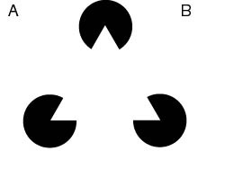
Perceptual Organization in Human Vision (II)
Some basic questions - Example: The law of closure
What to compute? How to compute?

Slide 46
Basic Concepts of Graphs
A graph G = (V, E) is an ordered pair that consists of a set of vertices and a set of edges that connect pairs of distinct vertices.
A graph is weighted if a number is assigned to each edge.
Directed graph versus undirected graph.
A bipartite graph is a graph whose vertices can be divided into two sets such that all edges connect a vertex in one set with a vertex in the other set.

Slide 47
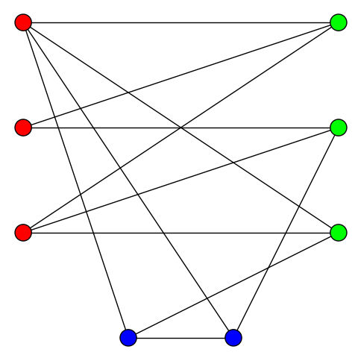
Example of a Graph that is not Bipartite
http://en.wikipedia.org/wiki/Bipartite_graph

Slide 48
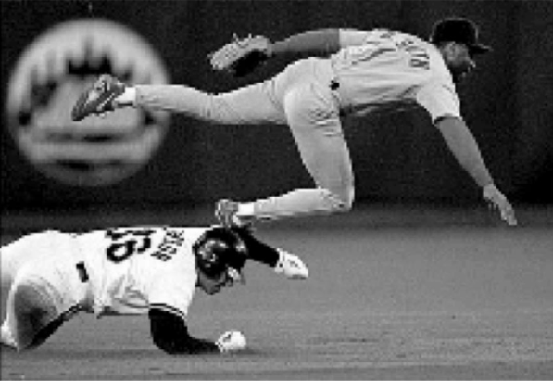
Basic Concept of Graph Cuts
A graph G = (V, E) can be partitioned into two disjoint sets A, B
Each vertex represents a pixel within the image.
The weight of the edge connecting two vertices represents their similarity.
A
B
Shi & Malik, PAMI, 22:888-905, 2000

Slide 49
谢谢同学们！

